Slide 1
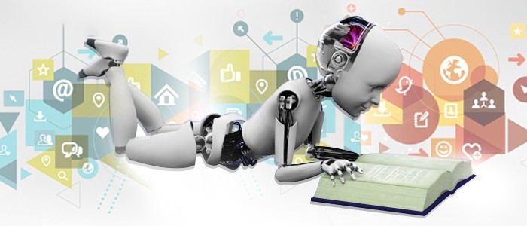

Machine Learning Operationalization (MLOps)
R. Joseph Manoj Ph.D.

Slide 2
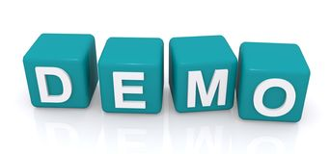
Session Plan
Basics of Data Science
Data Science Life Cycle
Roles in Data Science Life Cycle
Basics of Machine Learning Model
MLOps – Machine Learning Operationalization
Data Analysis using Tableau
ML Model Development
ML Model Deployment
ML Model in Production
Deep Learning & NLP Fundamentals
Research Areas – Computer Vision

Slide 3
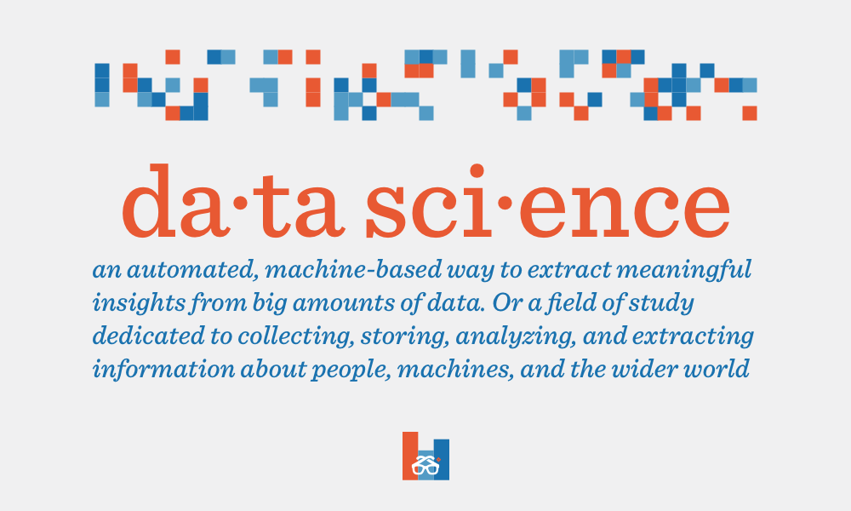

Slide 4
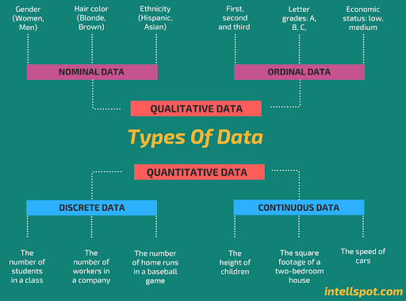

Slide 5
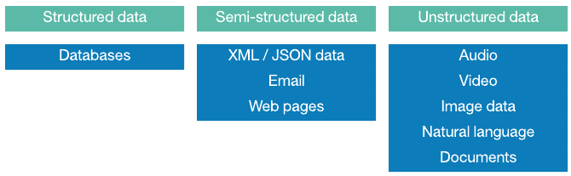

Slide 6
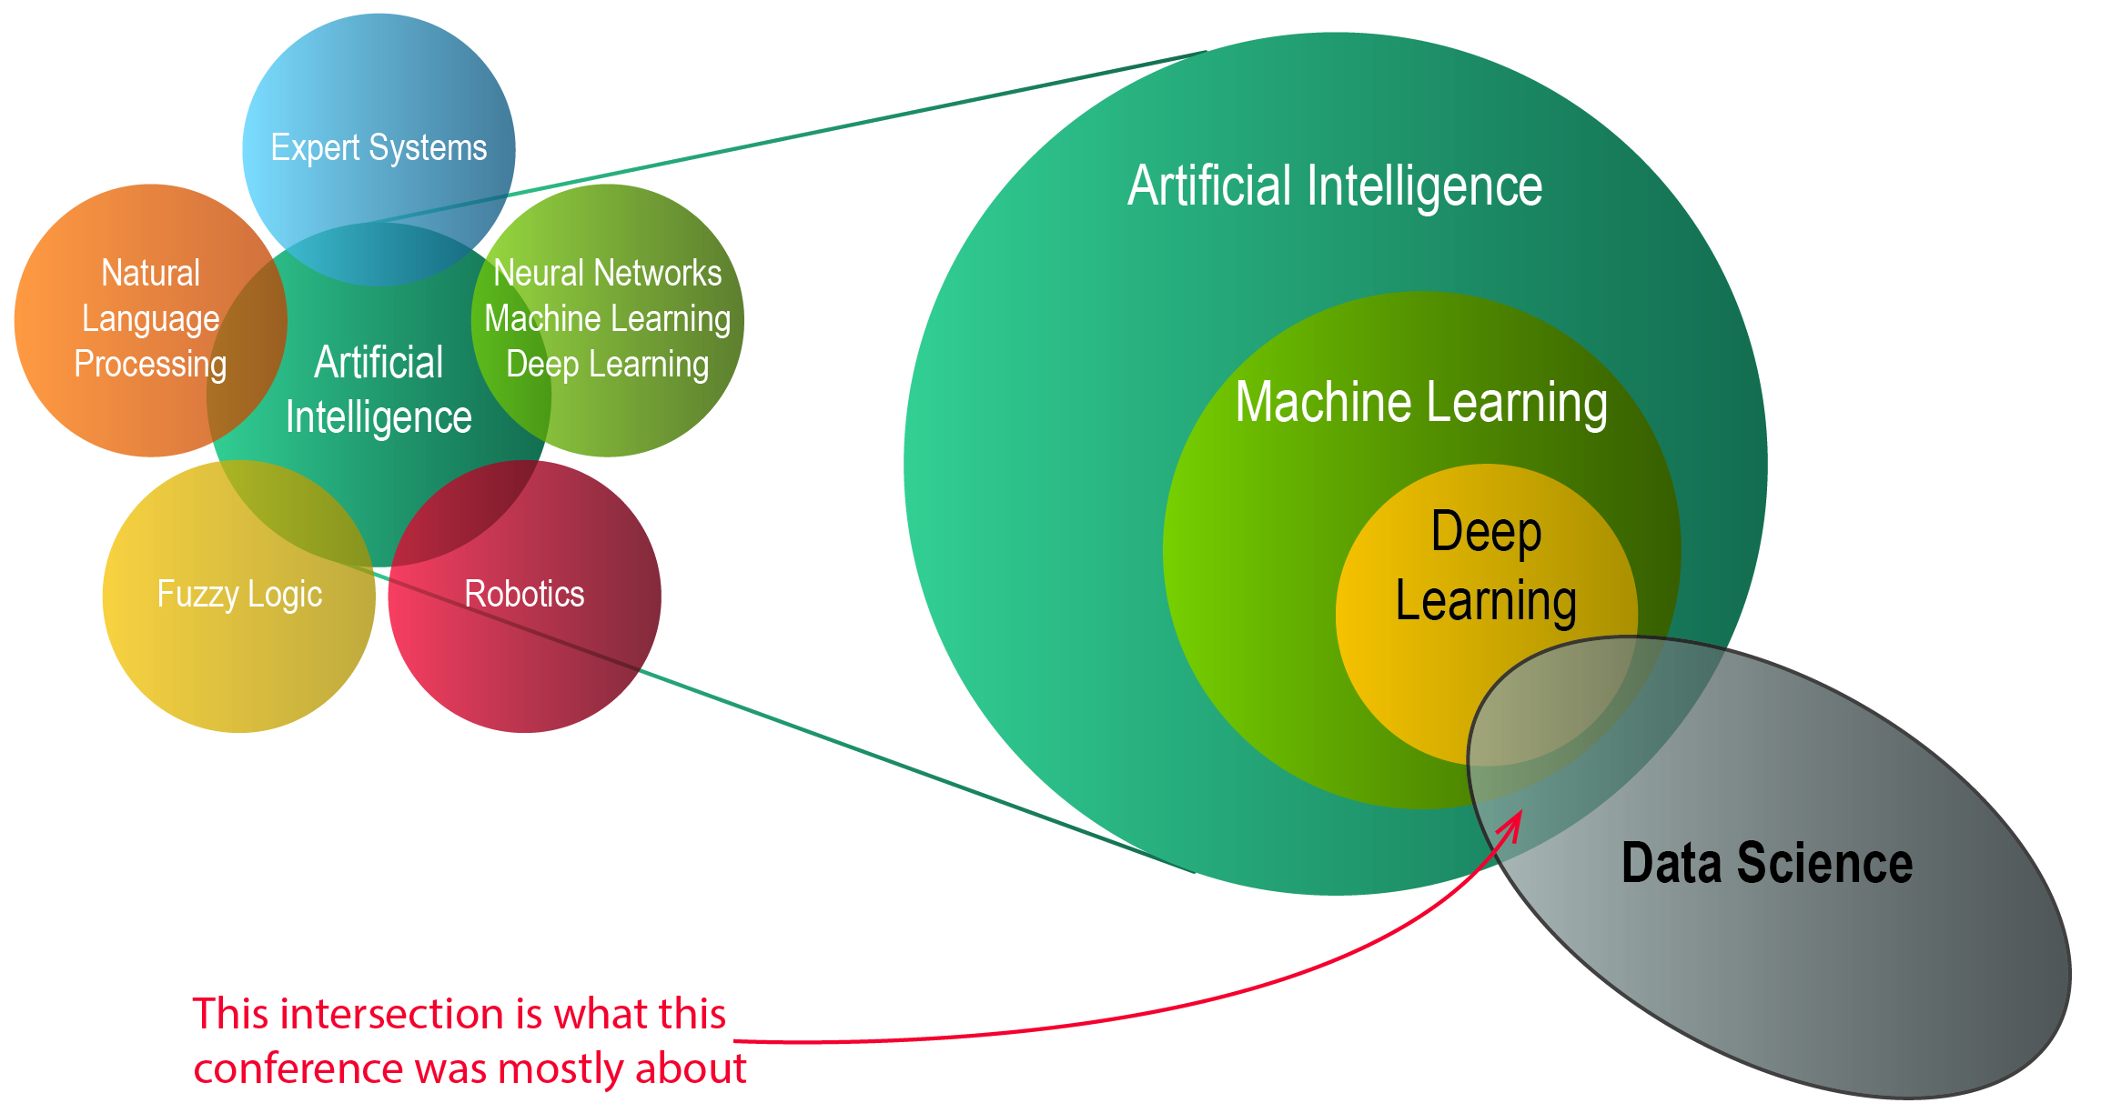

Slide 7
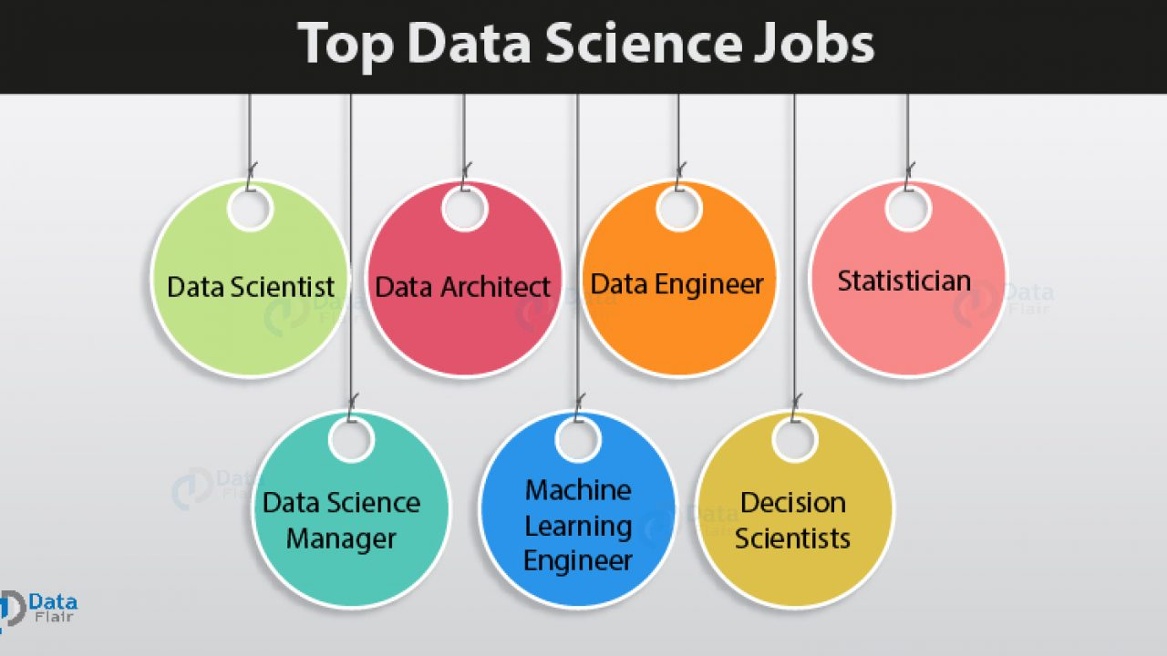

Slide 8
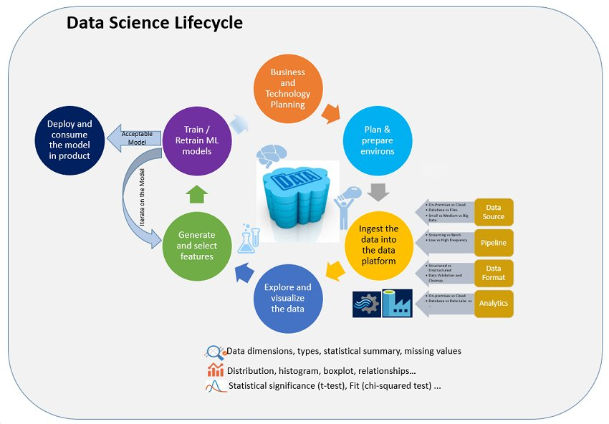

Slide 9
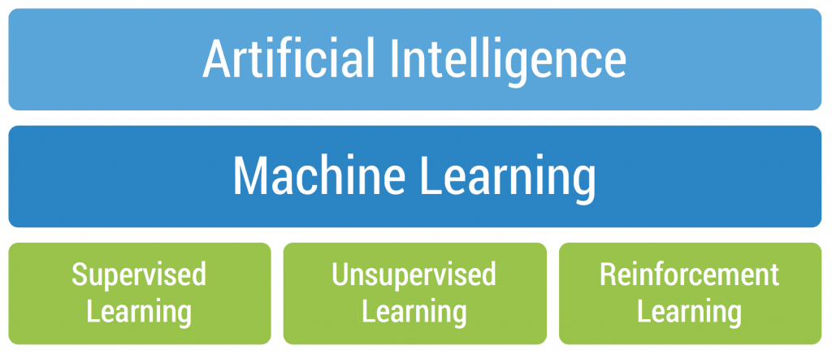
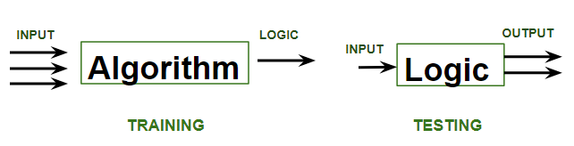
ML Algorithms – An Overview

Slide 10
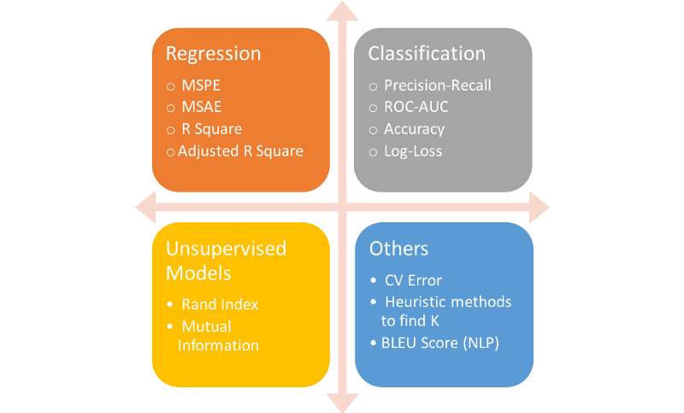
ML Algorithms: Performance Metrics

Slide 13
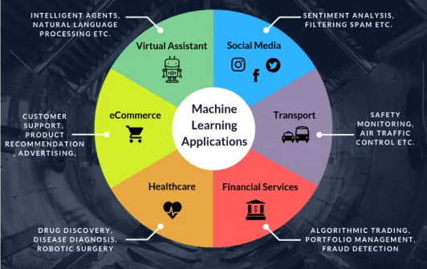

Slide 14
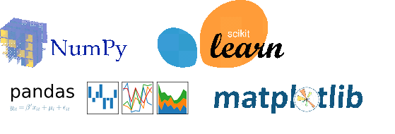

Slide 15

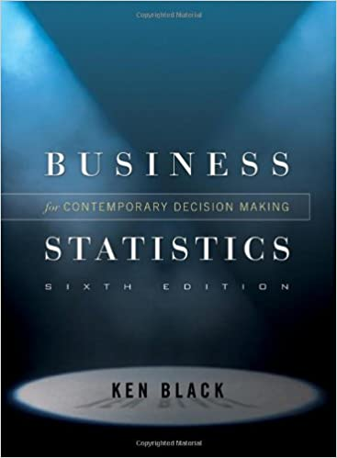
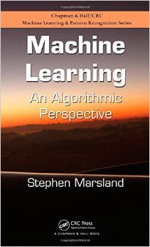


Slide 16


Slide 17
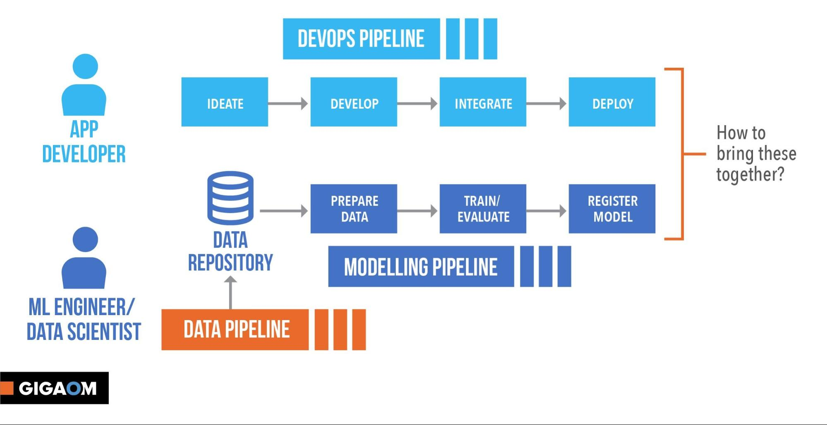

Slide 18
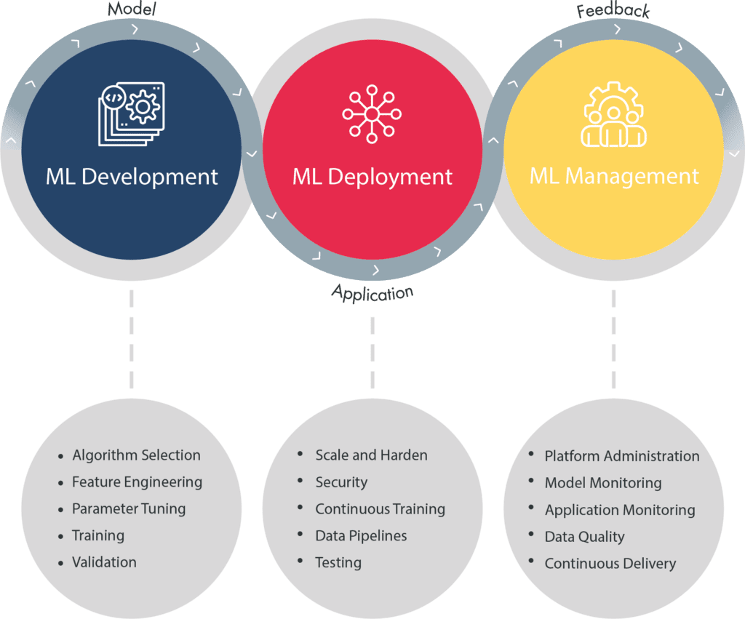
MLOps – ML Life Cycle Management
MLOps is a practice for collaboration and communication between data scientists and operations professionals to help manage production ML.
MLOps looks to increase automation and improve the quality of production ML

Slide 19
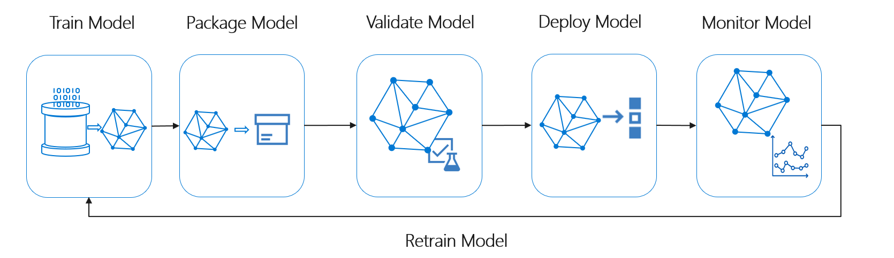

Slide 20

1. ML Model Development

Slide 21
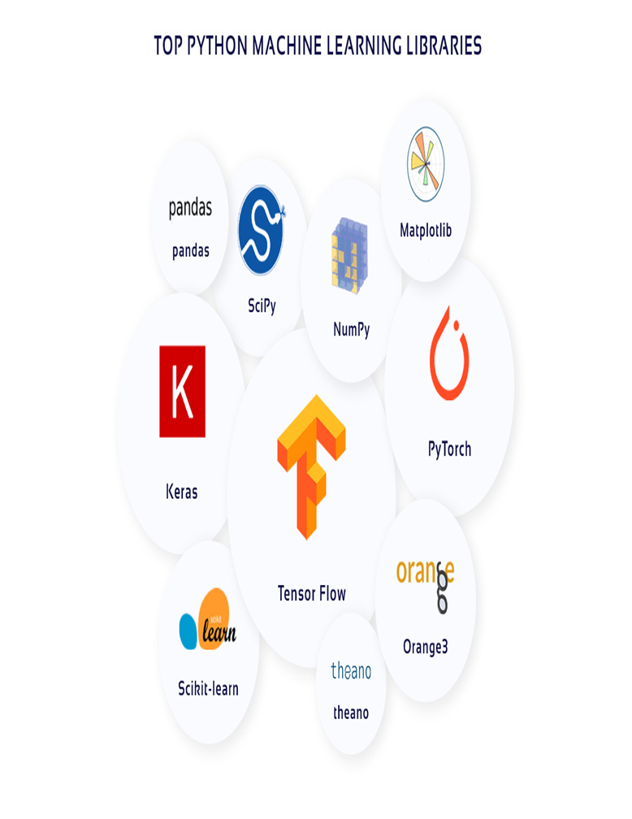
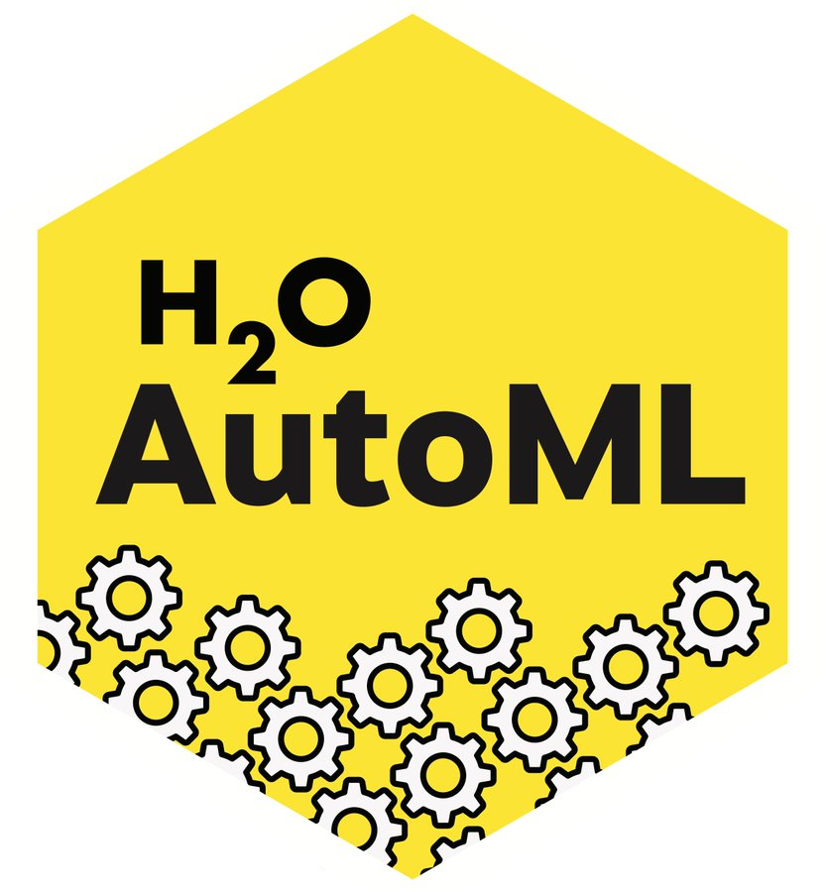
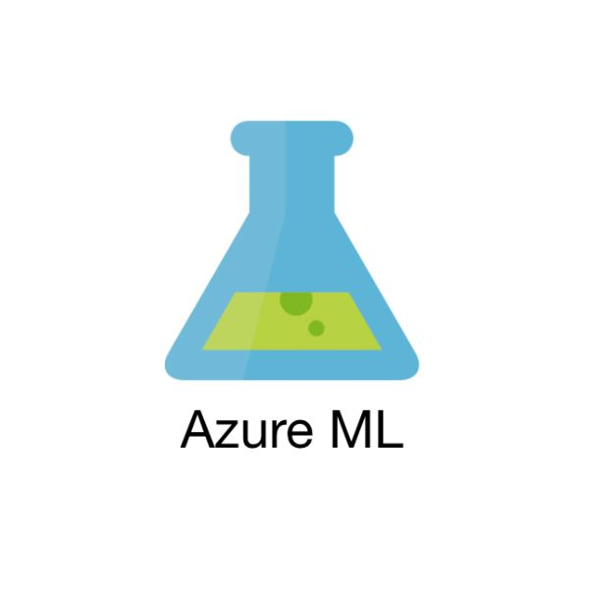

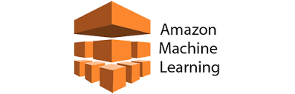
CustomML Vs AutoML

Slide 22
2. ML Model Deployment
Deployment is the method by which you integrate a machine learning model into an existing production environment to make practical business decisions based on data.
Pickle converts a python object to a bitstream and allows it to be stored to disk and reloaded at a later time. It is provides a good format to store machine learning models provided that their intended applications is also built in python
ONNX the Open Neural Network Exchange format, is an open format that supports the storing and porting of predictive model across libraries and languages. Most deep learning libraries support it and sklearn also has a library extension to convert their model to ONNX’s format.
Cloud – based deployment – Azure/AWS using Docker/Functions

Slide 23
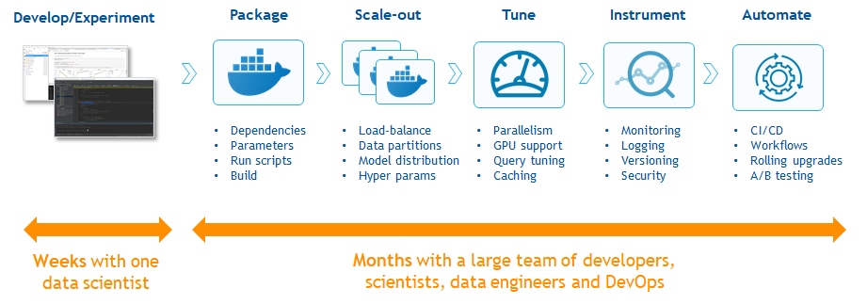
3. ML Model Management

Slide 24
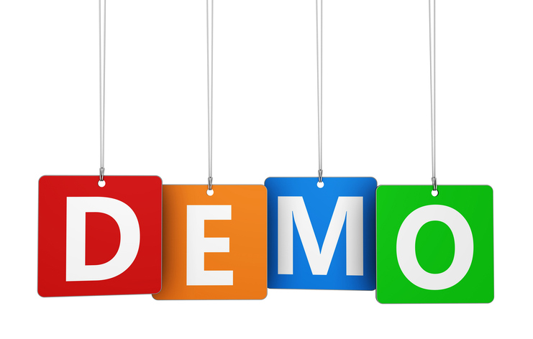
Data Analysis using Tableau
CustomML Development – Churn Prediction
ML Model in Production – Postman, Azure Cloud, AWS Cloud
AutoML (CloudML) – H2O.ai, MS Azure ML, AWS Sagemaker

Slide 25
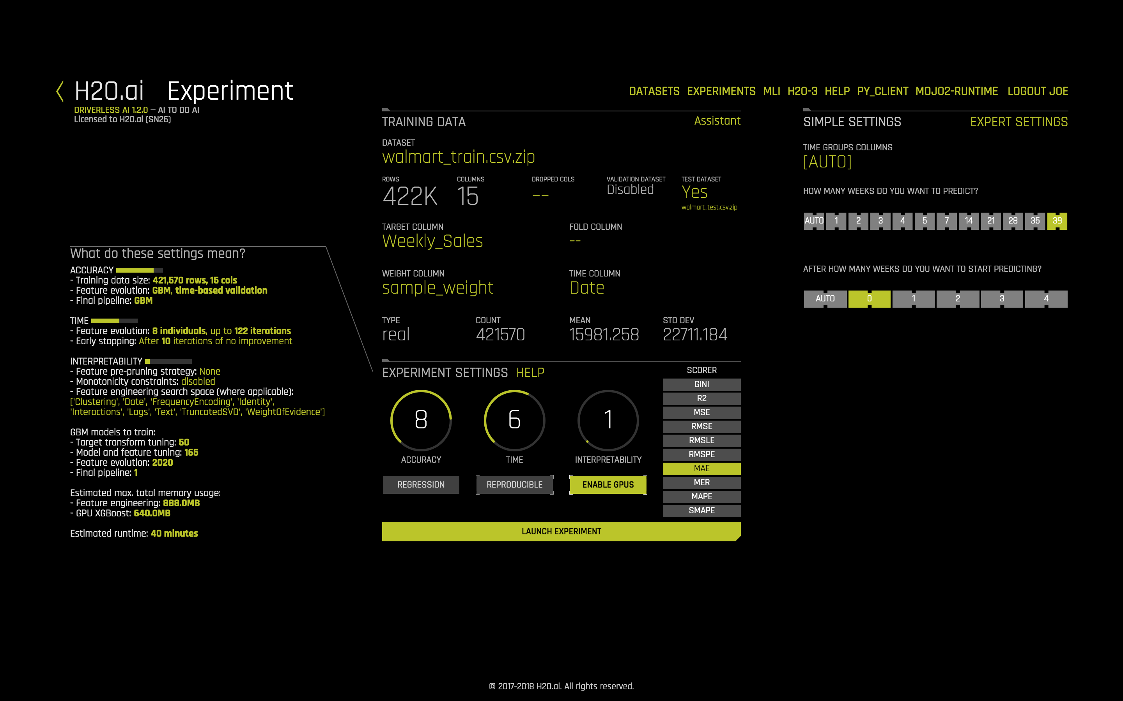

Slide 26
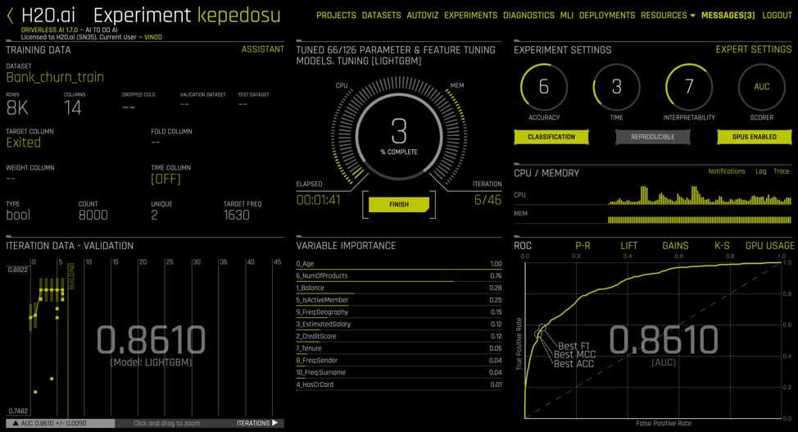

Slide 27


Slide 28


Slide 29
Natural Language Processing (NLP)
Natural language processing (NLP) is the ability of a computer program to understand human language as it is spoken. NLP is a component of Artificial Intelligence.
Syntax and semantic analysis are two main techniques used with natural language processing.
Syntax techniques used include parsing (grammatical analysis for a sentence), word segmentation (which divides a large piece of text to units), sentence breaking (which places sentence boundaries in large texts), morphological segmentation (which divides words into groups) and stemming (which divides words with inflection in them to root forms).
Semantics involves the use and meaning behind words. NLP applies algorithms to understand the meaning and structure of sentences.
NLP uses with semantics include word sense disambiguation (which derives meaning of a word based on context), Named Entity Recognition (which determines words that can be categorized into groups), and Natural Language Generation (which will use a database to determine semantics behind words).
Current approaches to NLP are based on deep learning

Slide 30
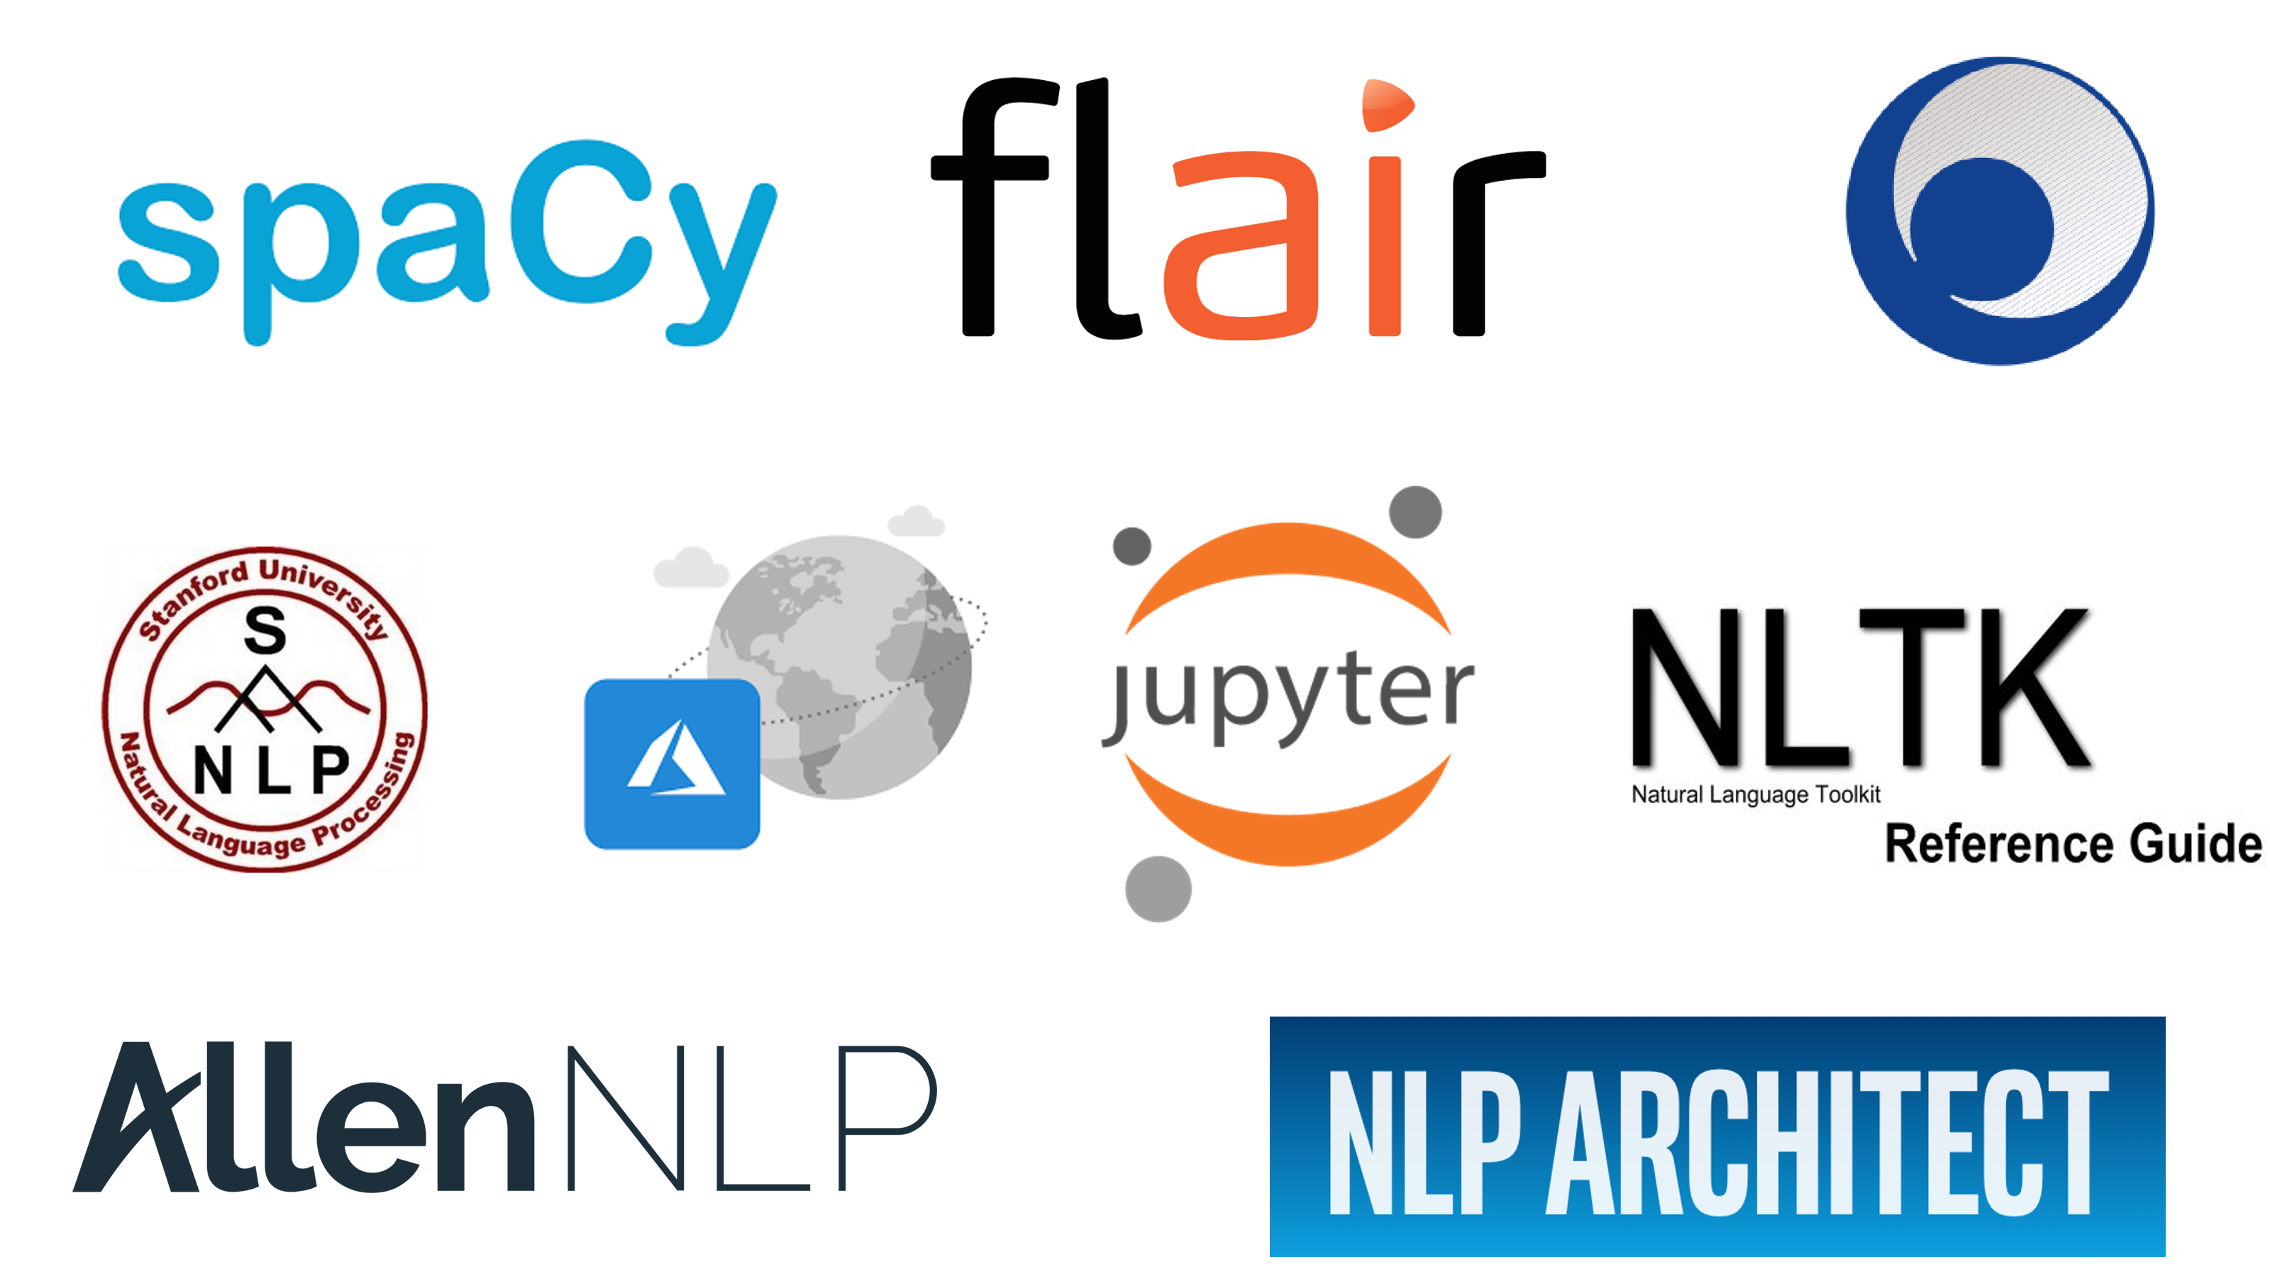

Slide 31
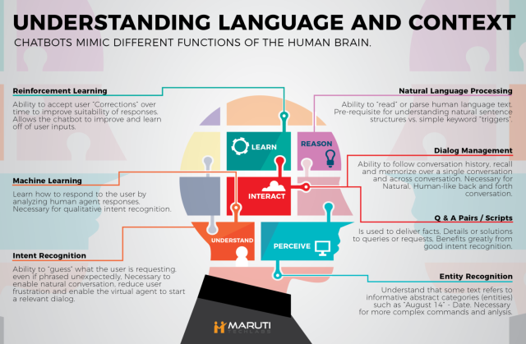

Slide 32
Deep Learning
Deep learning is an Artificial Intelligence(AI) function that imitates the workings of the human brain in processing data and creating patterns for use in decision making.
Models are trained by using a large set of labeled data and neural network architectures that contain many layers.
Deep learning is a class of machine learning algorithms that use several layers of nonlinear processing units for feature extraction and transformation. Each successive layer uses the output from the previous layer as input.
High-performance GPUs have a parallel architecture that is efficient for deep learning.

Slide 33
Deep Learning Networks
Text processing, sentiment analysis, parsing and name entity recognition, use a recurrent net or recursive neural tensor network or RNTN;
Any language model that operates at character level, Speech recognition, Time-series use recurrent net (RNN).
Image recognition, use deep belief network (DBN) or convolutional network (CNN).
Object recognition, use a RNTN or a convolutional network.

Slide 34
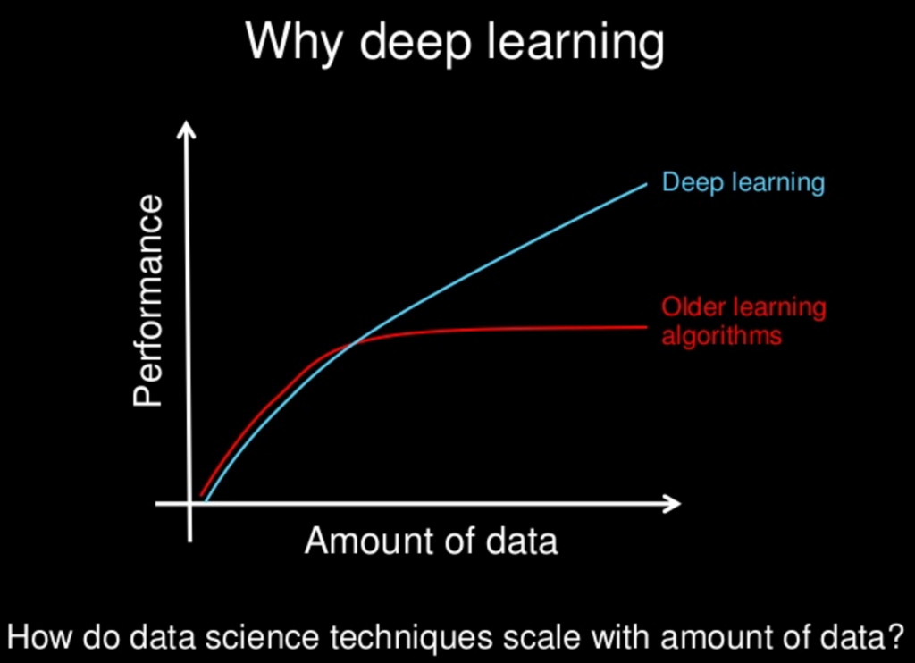

Slide 35
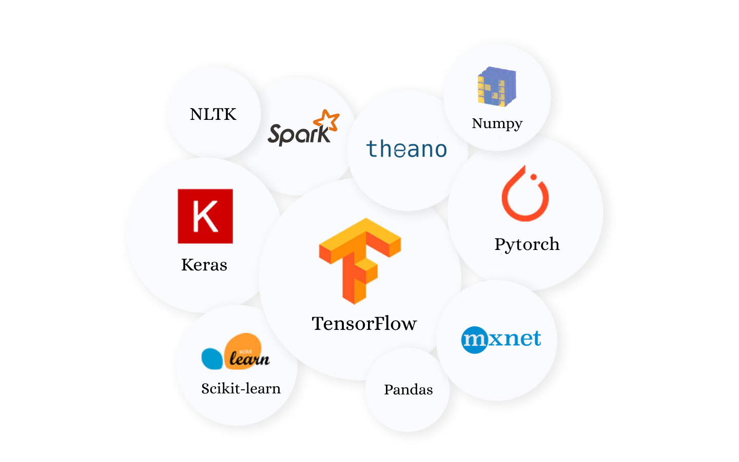

Slide 36
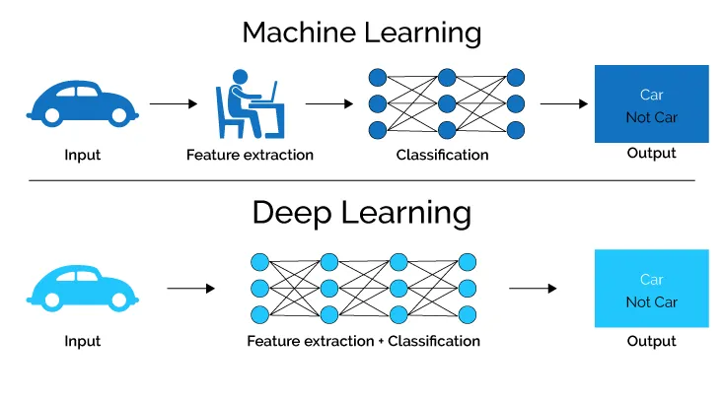

Slide 37
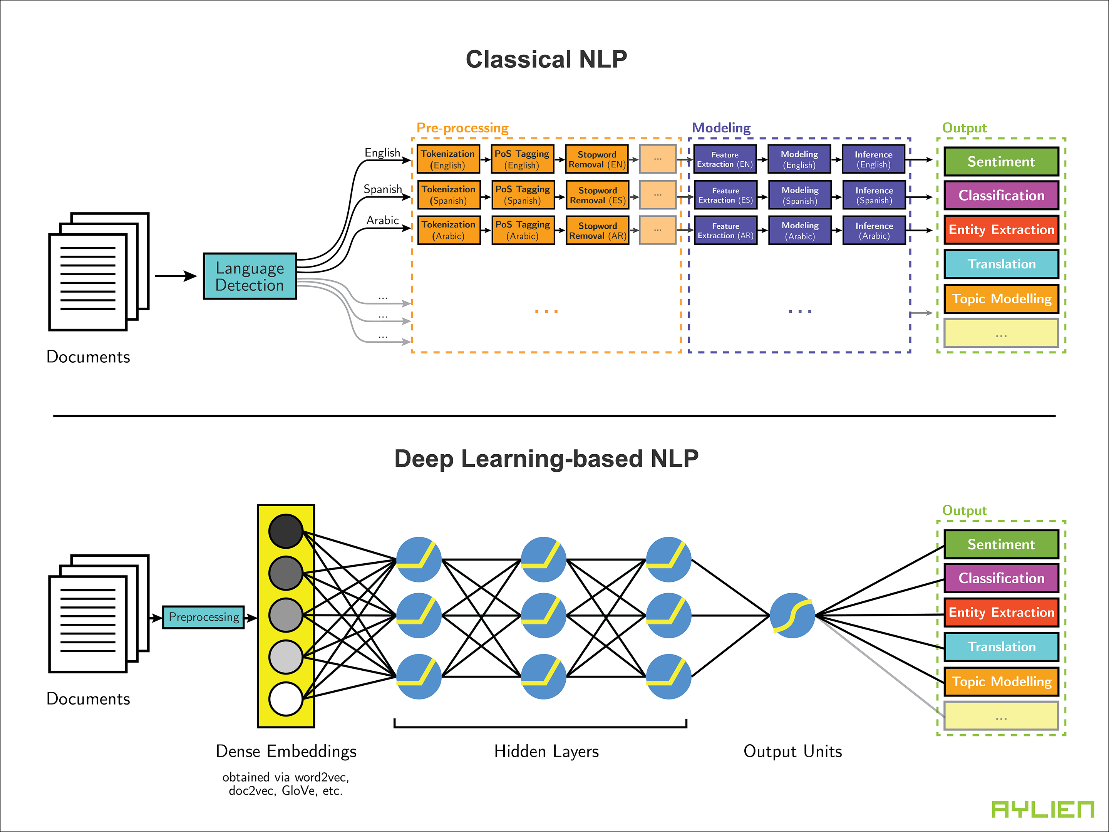

Slide 38
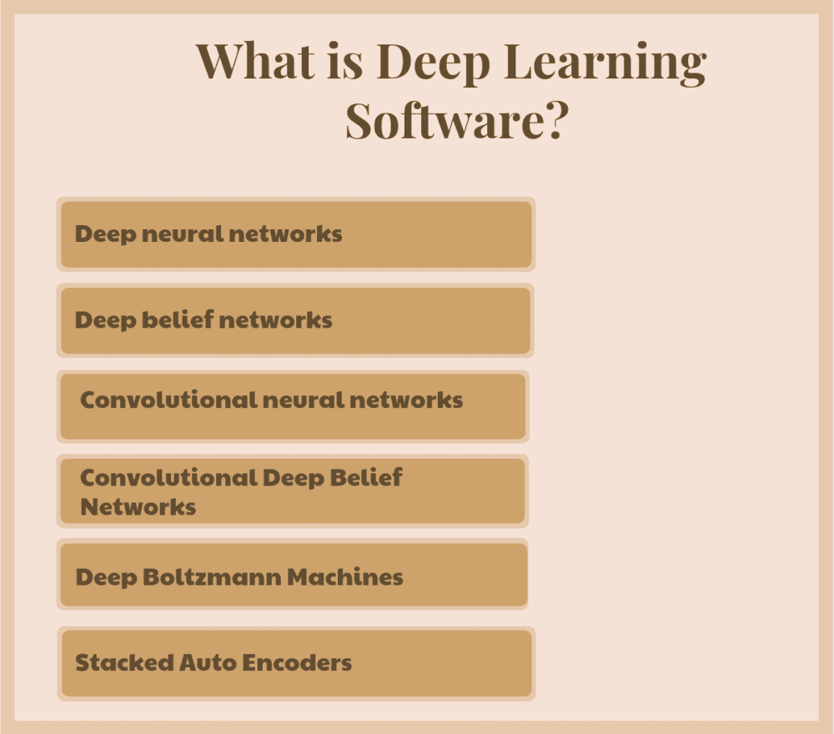

Slide 39


Slide 40
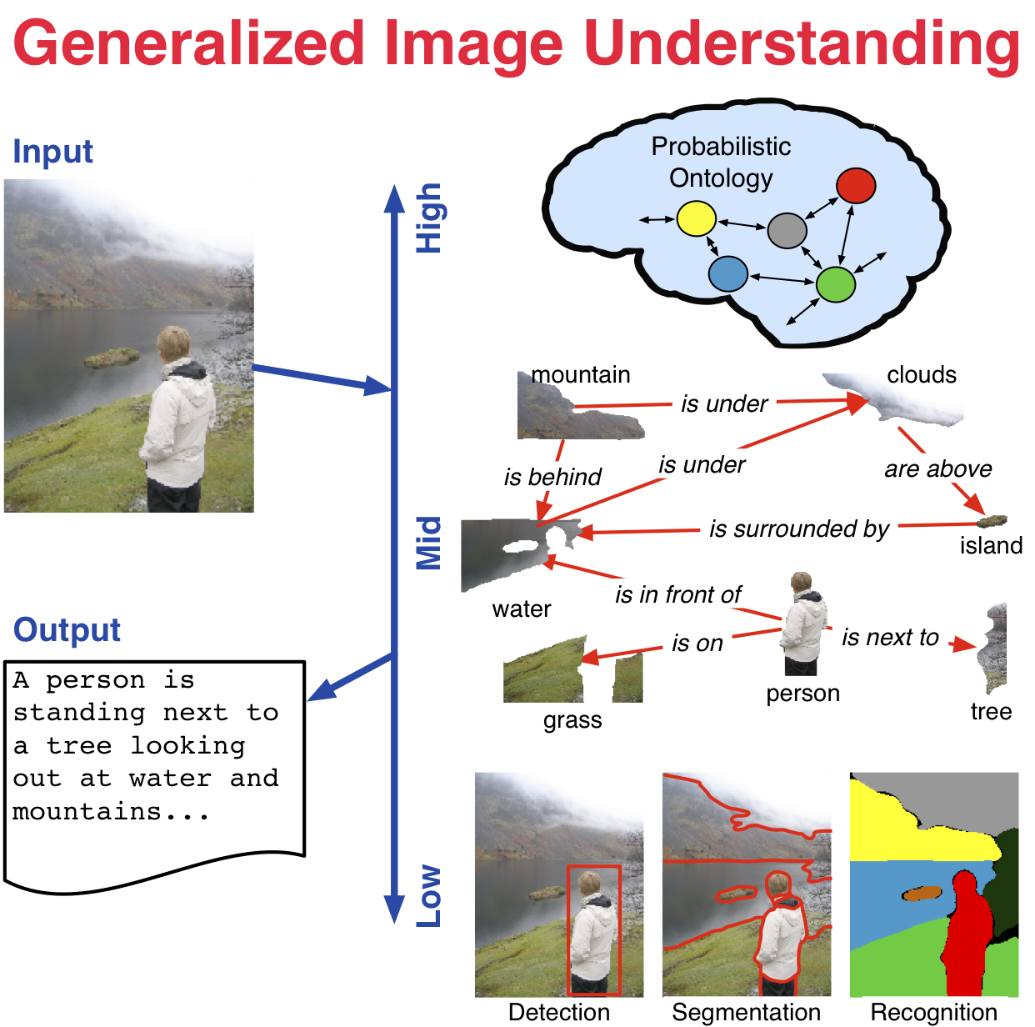

Slide 41
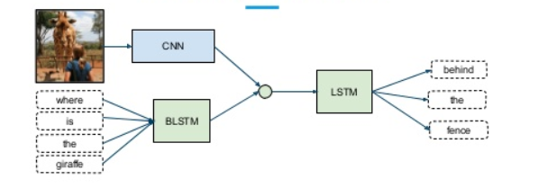

Slide 42
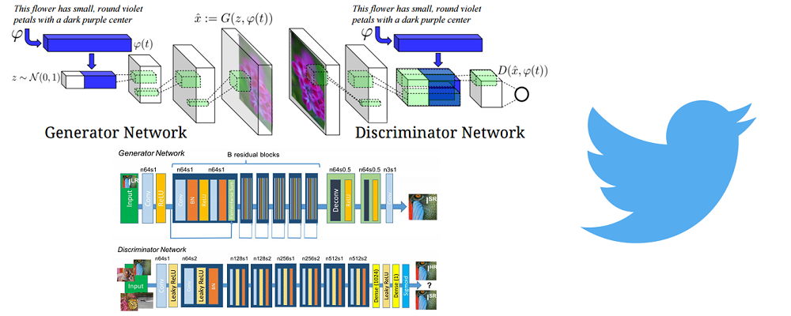

Slide 43
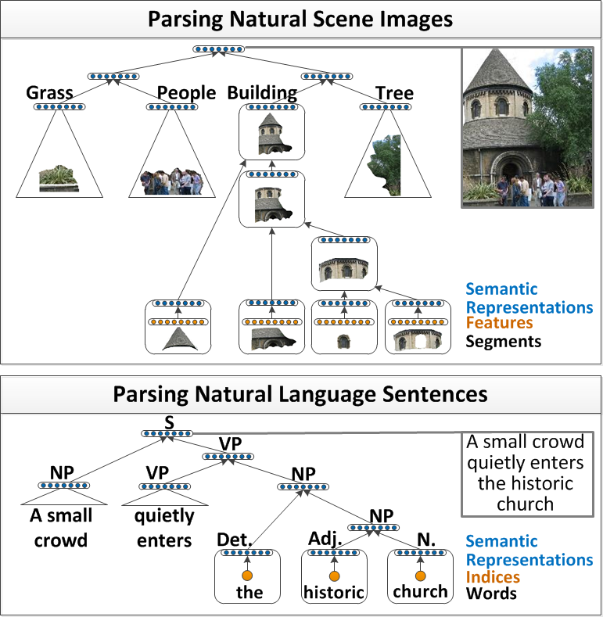

Slide 44
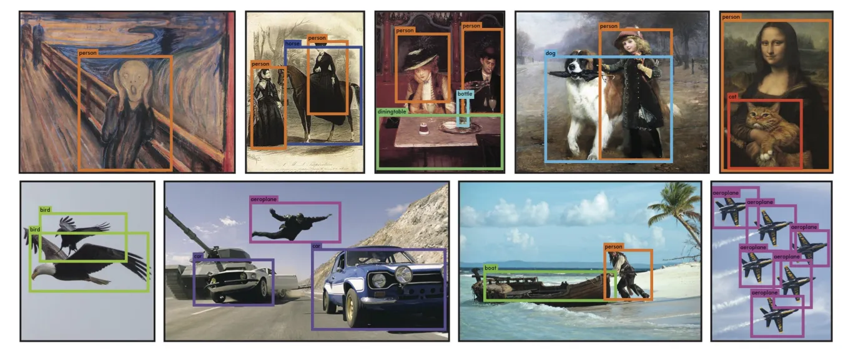

Slide 45
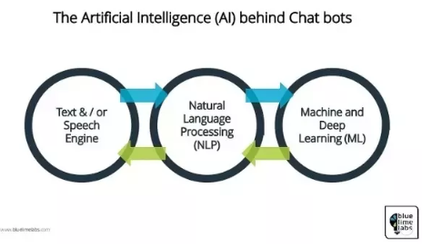

Slide 46
